Slide 1
Preview p.78
Who are the explorers that we have discussed so far?
What were their accomplishments?

Slide 2
Preview p.78
Prince Henry (Portugal) – Conquered Muslim city of Ceuta in North Africa
Vasco da Gama (Portugal) – direct sea route to India
Christopher Columbus (Spain) – Caribbean island

Slide 3
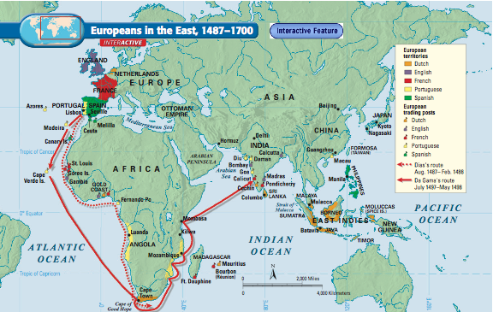

Slide 4
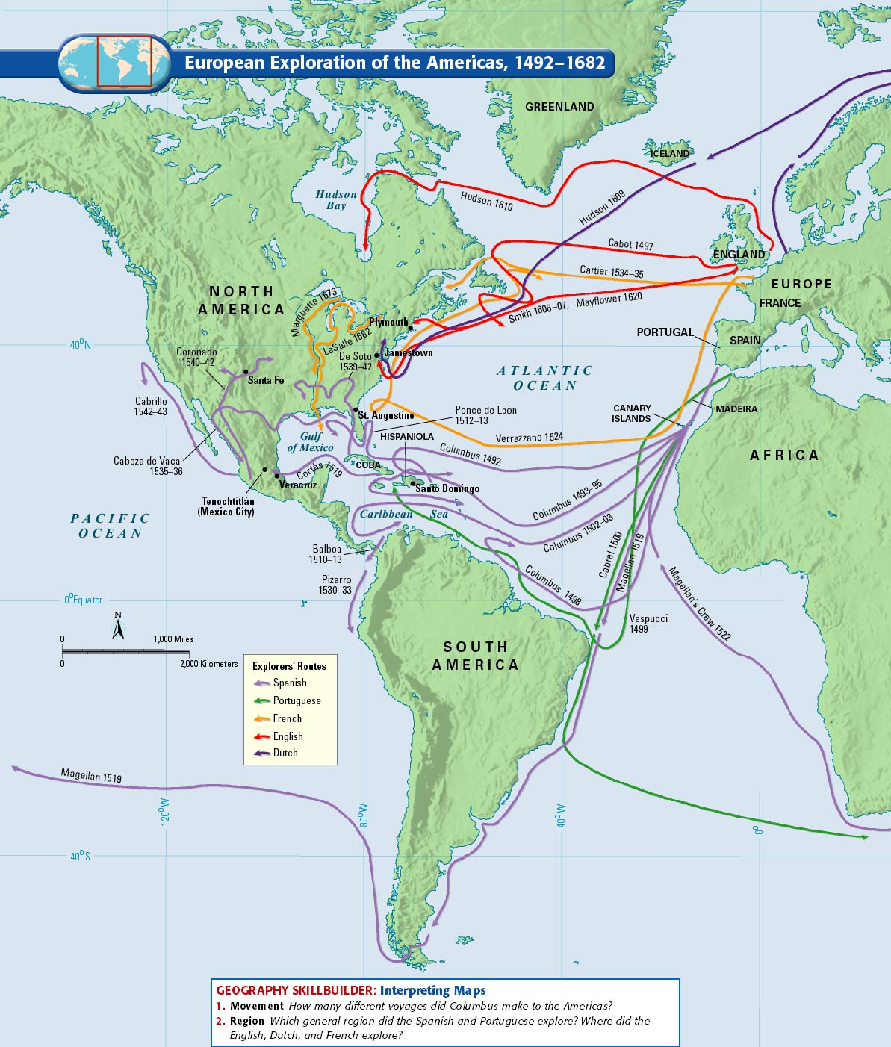
The Atlantic World p.103

Slide 5
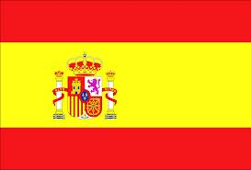
The Atlantic World p.79
Spain
1513 – Ponce de Leon conquers Florida
1521- Hernando Cortés conquers the Aztecs in Mexico
1532 - Francisco Pizarro conquers the Inca in Peru

Slide 6
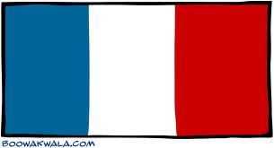
The Atlantic World p.79
France
Jacques Cartier named St. Lawrence River and then Montreal
Samuel de Champlain founded Quebec
La Salle explored claimed lower Mississippi and named it Louisiana

Slide 7
The Atlantic World p.79
England
1607 – English colonists claim Jamestown off the coast of Virginia
1620 – Pilgrims found Plymouth in Massachusetts

Slide 8
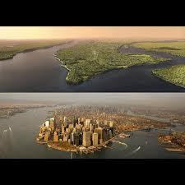
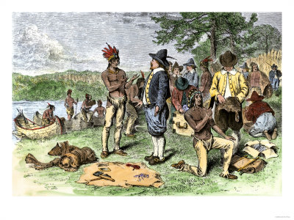
The Atlantic World p. 79
Dutch
Henry Hudson built trading posts in Albany and Manhattan Island

Slide 9
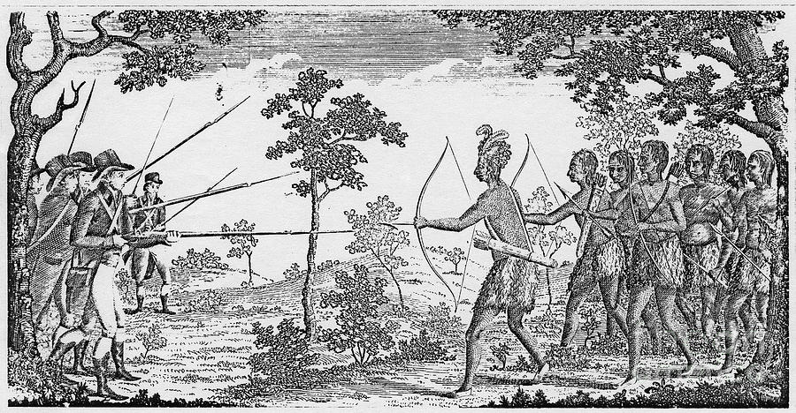

Slide 10
The Atlantic World p.79
Map p. 564
Which nation claimed the largest area of the present-day United States in 1754?
How did Britain’s North American empire change by 1763?

Slide 11
Process p.78
Native Americans Respond- What are some of the grievances of the Native Americans towards the colonists?

