Slide 1
Preview p.80
What do you know about memorials?
Have you ever seen one?
What is its purpose?
What kinds of events do we build memorials for?
Do you think there should be a national memorial for slavery?

Slide 2
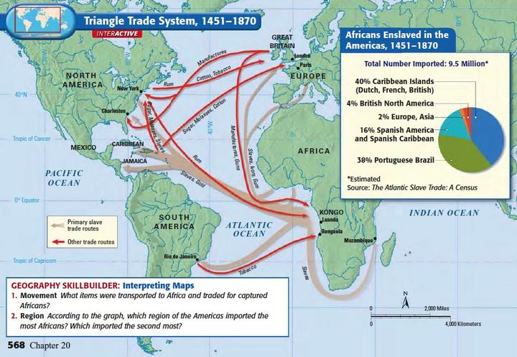

Slide 3
Background Reading #1
What drove the European interest in slaves from Africa?
How did Africans get to the ships?

Slide 4
Mortality Rate Chart
Why would large portions of slaves on a ship die during the voyage?
How did the chart’s author determine the mortality rate of each voyage?
What factors do you think might make a mortality rate higher or lower on a voyage?
Why might the ship Nancy have had a mortality rate of 100%?
What is the estimated overall mortality rate of the Middle Passage?

Slide 5
Background Reading #2
Describe the conditions on the decks where the slaves were kept.
What were the causes of slave deaths aboard the slave ships. List at least 6 causes of death.
Do you think the crews on slave ships wanted to hurt the slaves? Why or why not?
List at least 3 things that would prompt the crew to kill a slave.

Slide 6
Document A
“Space on the slave decks”
Why did the slaves have to lie only on their sides?
Why were the European slavers packing the slaves so tightly?

Slide 7
Document B
“Food”
What would happen to slaves who refused to eat?
Why do you think they tortured slaves who did not want to eat?

Slide 8
Document C
Ventilation of the Ships
How did Alexander Falconbridge attribute poor weather to an increase in disease?
Why did the interior of the slave ship look like a “slaughter house?”

Slide 9
Document D
“Jumping Overboard”
Why do you think some slaves wanted to jump overboard?
What did the sailors do to the slave who they rescued from drowning? Why do you think they did that to him?

Slide 10
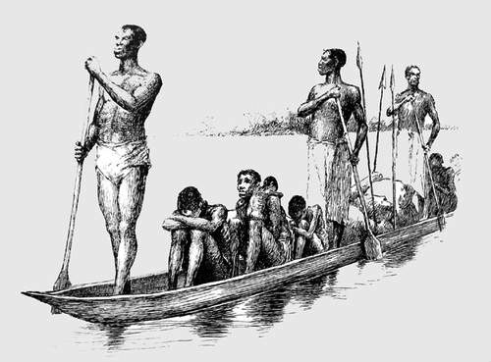

Slide 11
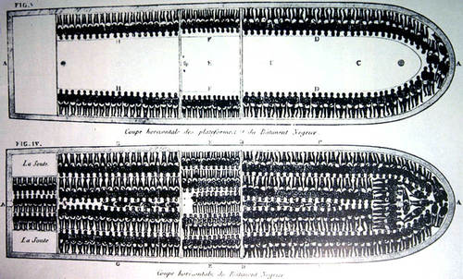

Slide 12
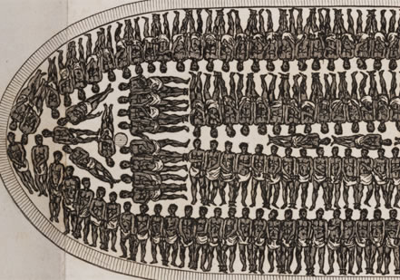

Slide 13
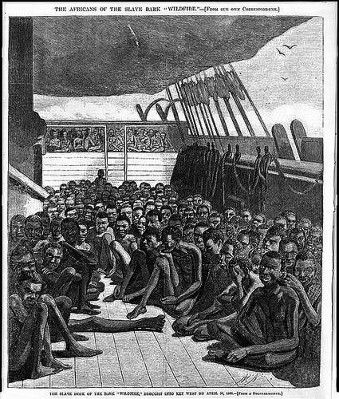

Slide 14
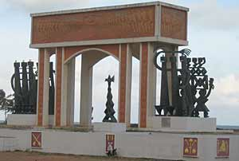
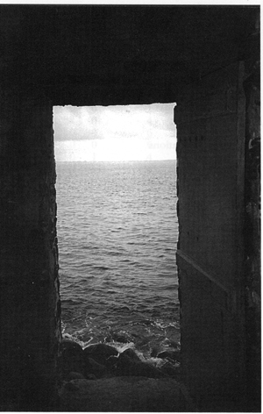
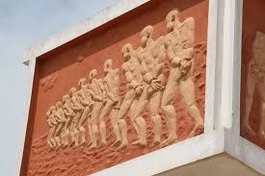
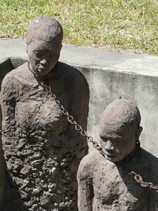

Slide 15
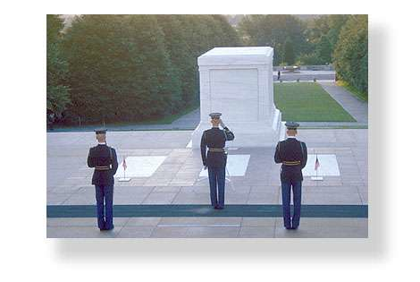
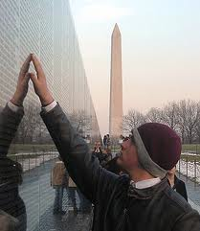
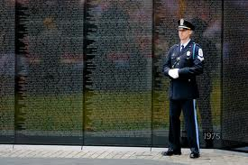

Slide 16
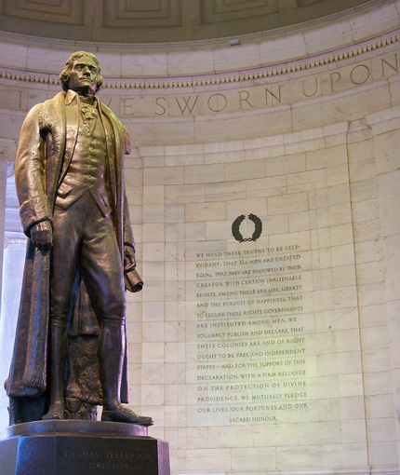

Slide 17
Jefferson Memorial
"God who gave us life gave us liberty. Can the liberties of a nation be secure when we have removed a conviction that these liberties are the gift of God? Indeed I tremble for my country when I reflect that God is just, that his justice cannot sleep forever. Commerce between master and slave is despotism. Nothing is more certainly written in the book of fate than that these people are to be free. Establish a law for educating the common people. This it is the business of the state and on a general plan."

Slide 18
Process p.80
Design a memorial to commemorate those who died on the Middle Passage. Your memorial must include:
An appropriate image, such as a statue or building.
An inscription which tells:
The event that the memorial commemorates
The relevant dates of the event
The people that it commemorates

