Slide 1
Preview p. 50
List some characteristics of Renaissance art

Slide 2
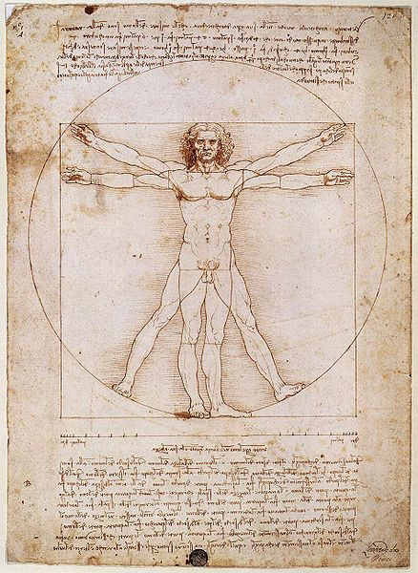
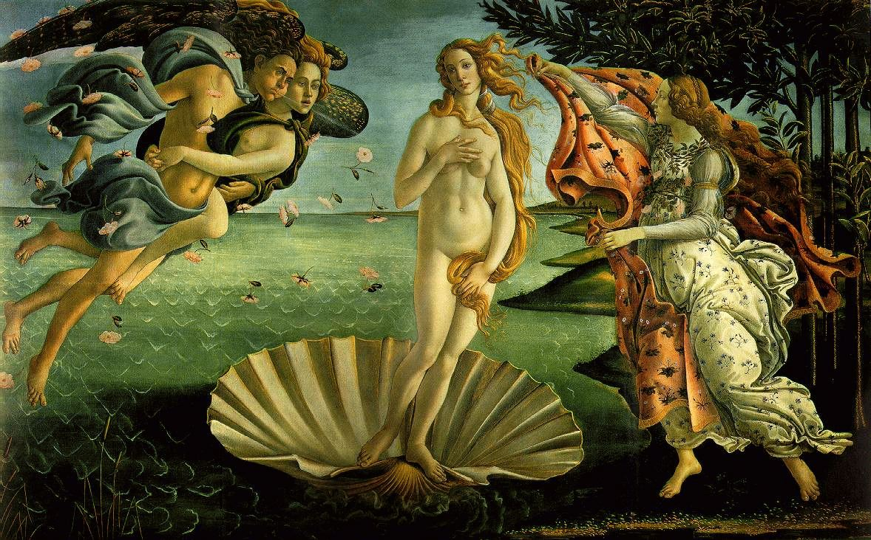
Why are these works considered Renaissance Art?

Slide 3
Renaissance Art p.50
Italians were willing to
spend a lot of money on art.
Art communicated social, cultural, and spiritual values
Italian banking and international trade interests had the money
Public art in Florence was organized and supported by guilds
Therefore, the consumption of art was a form of competition for social and political status.

Slide 4
Characteristics of Renaissance Art
1. Realism & Expression
Expulsion from the Garden
Masaccio
1427
First nudes since classical times.

Slide 5
Characteristics of Renaissance Art
2. Perspective
The Trinity
Massaccio
1427

Slide 6
Characteristics of Renaissance Art
3. Classicism
Venus
Medici
Greco-Roman influence
Individualism
Secularism & Humanism

Slide 7
Characteristics of Renaissance Art
4. Emphasis on Individualism
Batista Sforza & Federico de Montefeltre: The Duke & Dutchess of Urbino
Piero delia Francesca
1465-1466

Slide 8
Characteristics of Renaissance Art
5. Geometrical Arrangement of Figures
The Dreyfus Madonna with the Pomegranite
Leonardo da Vinci
1469
The figure as architecture

Slide 9
Characteristics of Renaissance Art
6. Artists as Personalities
Lives of the Most Excellent Painters, Sculptors, and Architects
Giorgia Vasari
1550

Slide 10
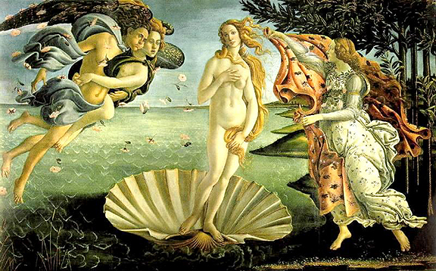
Birth of Venus (Botticelli 1486)

Slide 11
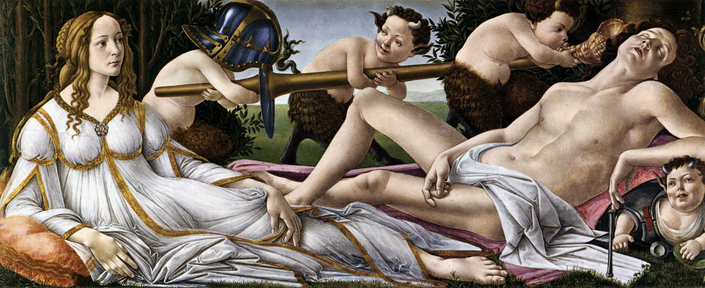
Venus and Mars (Botticelli 1483)

Slide 12
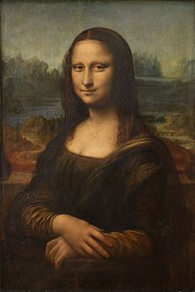
Mona Lisa (Da Vinci 1503-1505)

Slide 13
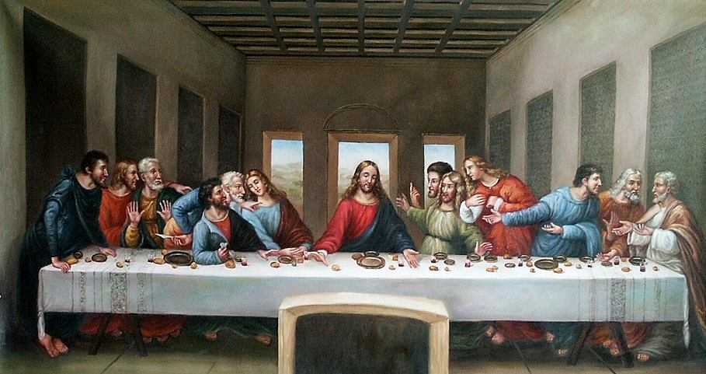
The Last Supper (Da Vinci 1495-1498)
Restored

Slide 14
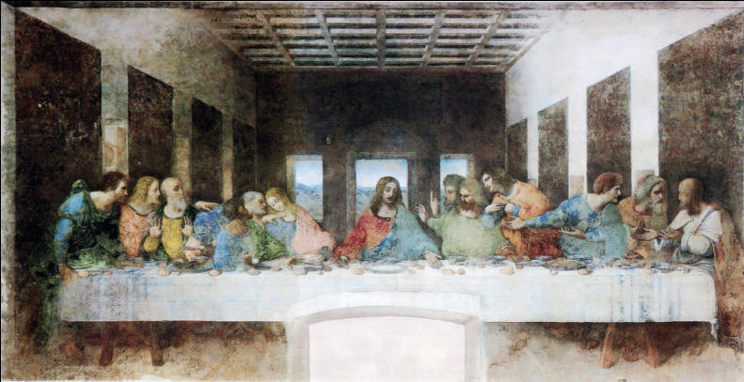
The Last Supper (Da Vinci 1495-1498)

Slide 15
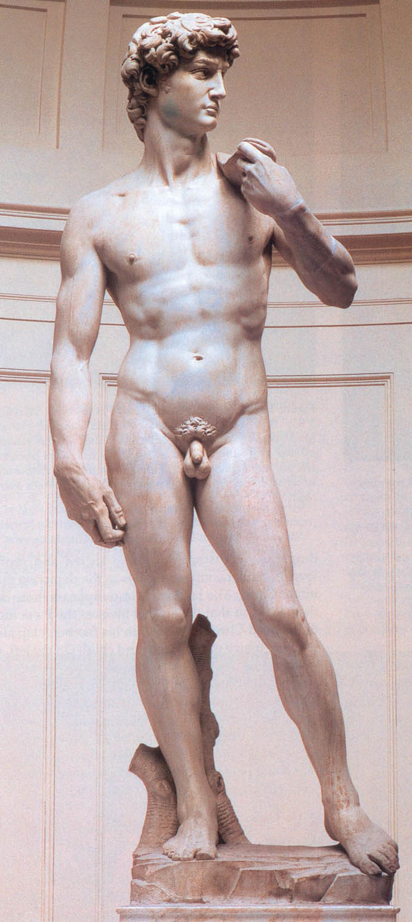
David (Michelangelo 1501-1504)

Slide 16
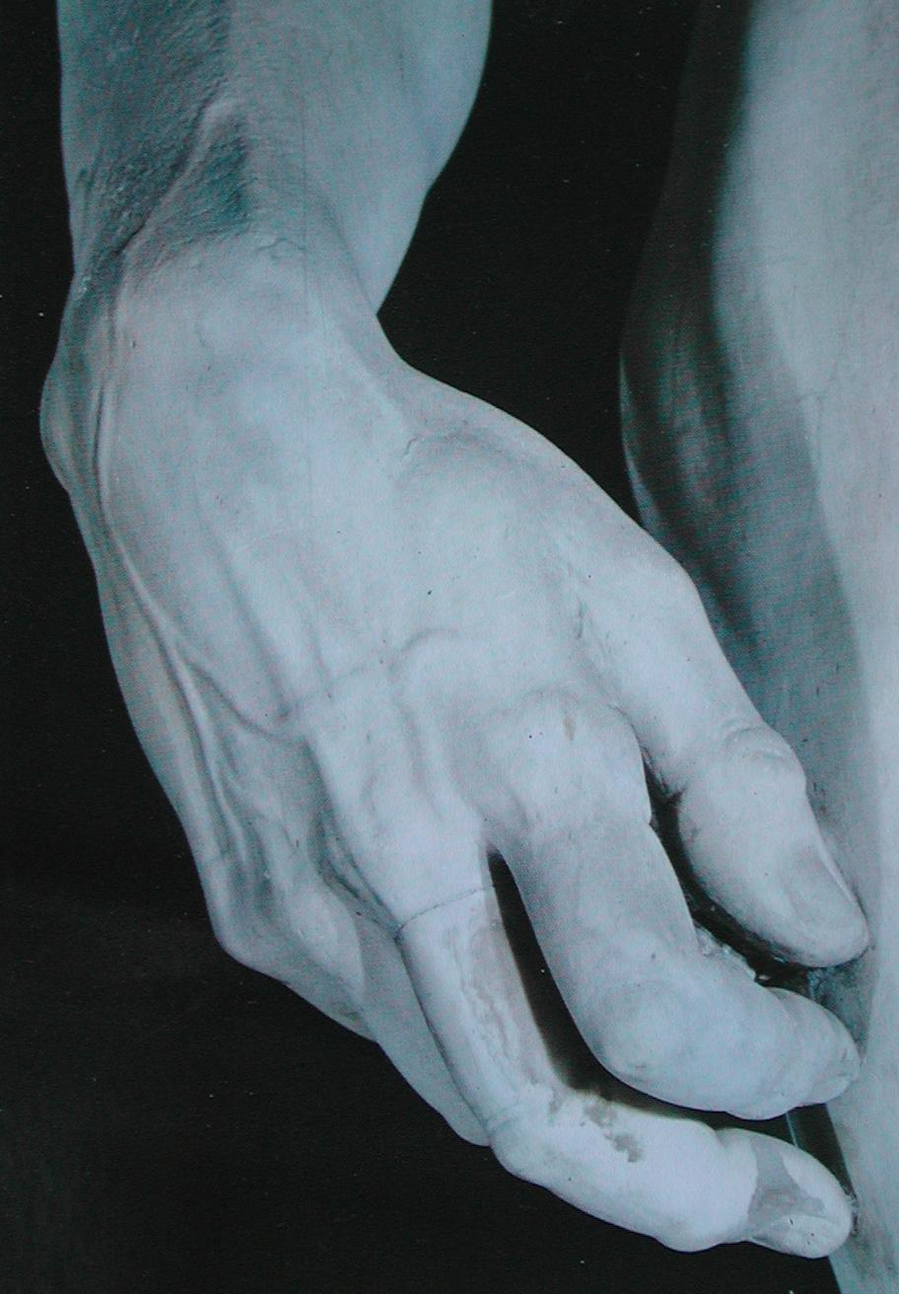
David (detail of right hand) Michelangelo

Slide 17
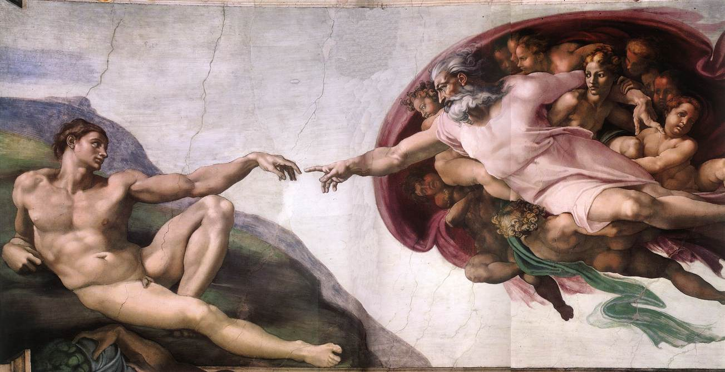
Creation of Adam (Michelangelo 1508-1512)

Slide 18
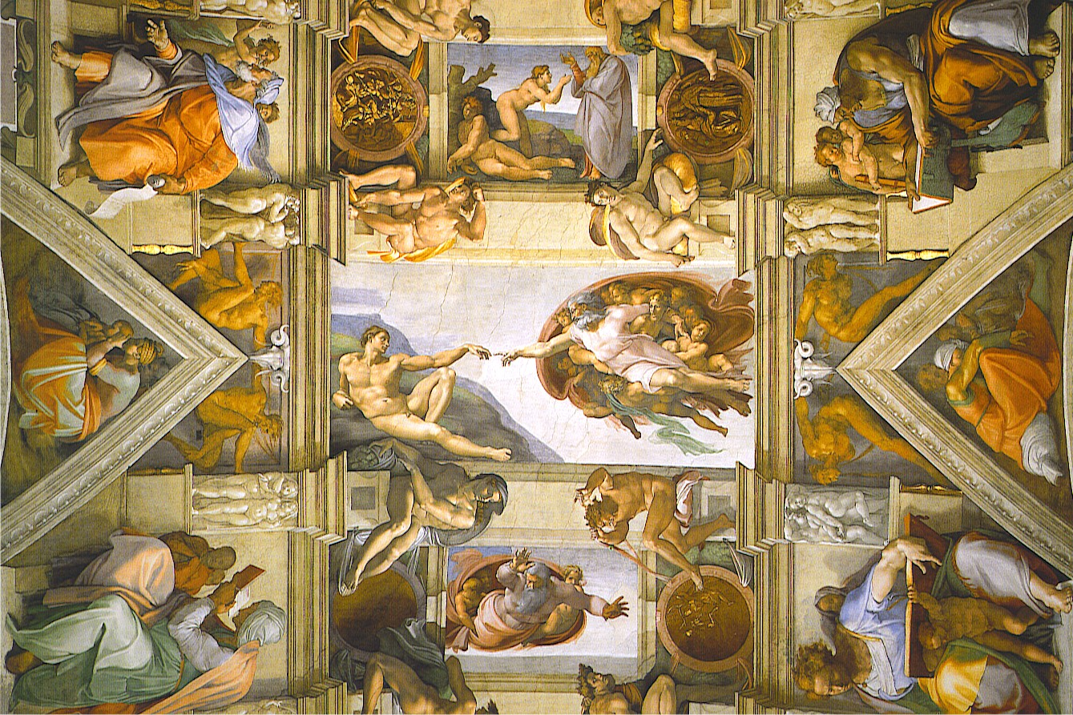

Slide 19
Renaissance Art Scavenger Hunt
Complete Webquest at:
http://www.sonic.net/bantam1/renart.html
Read biographies of Da Vinci and Michelangelo on textbook p. 475 and answer the following questions on the back of your worksheet.
How did Leonardo achieve fame?
Why was Michelangelo a successful artist?
How were the careers of these two artists different and alike?

Slide 20
Process p.50
What did you find most interesting about Renaissance art?

